Slide 1
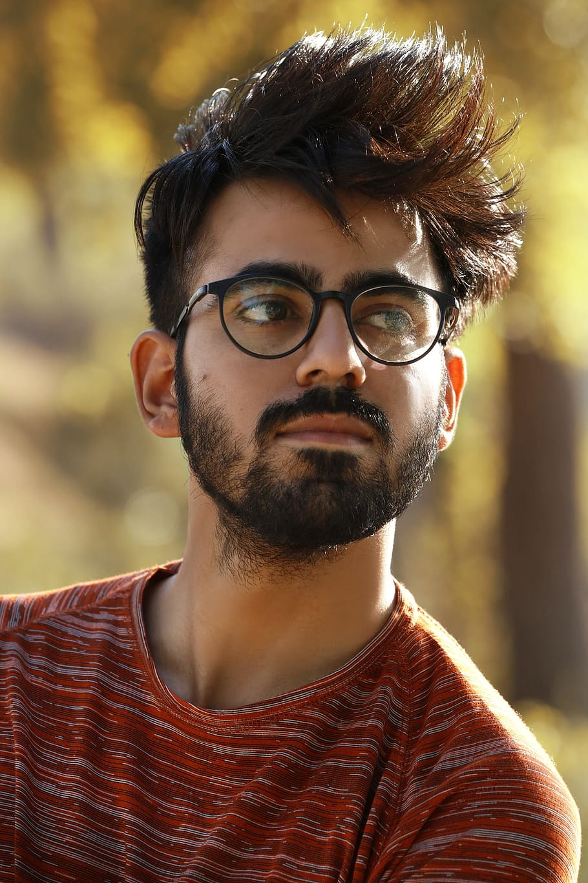
Projects Done
Education
Bachelor of Science in
Computer Science & Engineering , KUET,
Khulna.
CGPA: 3.62
E-commerce site for single vendor shop using php Laravel frameworks
Social media type e-commerce apps using android
Android app for helping the verbally disabled people
Smart security camera to save images online by detecting the motion
Database project for company management
Md Mahir Abrar Khan
Skills Highlights
C/C++,Python , Java
Android , Laravel
Tensorflow , Pytorch
Previous Experience
Working on multiple academic projects in different domains
Languages
About Me
Bangla , English , Urdu
A very passionate cs grad, full of enthusiasm , challenge loving , problem solver . Eagerly waiting to take challenges. Love to travel .
Contact Information
Operating Systems
Email: mahirabrar075@gmail.com
Fax: 98668
Phone: 689797
Github: MahirAbrar3425
Windows
Mac
Ubuntu

